Slide 1
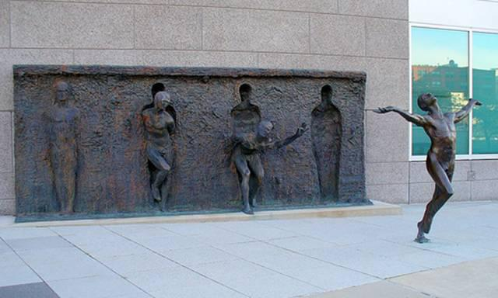
Personal Development & Team Leadership
Prof: Andrew PRIOR
Class 1: Morning-30Sep-2024

Slide 2
Personal Development & Team Leadership
Our class is called:
enables
Notes:
Without personal development there can be no eam leadership

Slide 3
The reason for this course:
To help you be more successful
Deepen self awareness of your unique leadership style and how it impacts creativity and innovation
Develop your leadership capability
Create and lead high performing teams
Present an inspirational and motivational vision to empower others to be succesful
Notes:
Relate to the Google article – researched 180 teams – a lot of data
Key findings that team performance related to norms (how the team behaves together):
1. EQ, being sensitive to others feelings and thoughts
2. Conversational equity – everyone in the team had equal conversation time
Hot topic. Researcher, consultant, coach and trainer
Recent studies on effective teams in Google and HBR (5000 articles on the topic). We all have theories about this.
The perfect team = The team alchemy!
What differentiates the top team from the bottom
What relevant from all this research, social science
Structured and scientific manner
Subjective question
Collected data from 180 teams
250 input variables
- Composition, who, history, preferred styles
Team dynamics, norms, goal setting recognizing work
Looked at quantitative and qualitative data
What makes the perfect team?
Less about who and more about how they interact
5 common themes
Psychological safety (being able to take a risk on the team without feeling insecure or embarrassed) – “Trust/respect & Dialogue” – Amy Edmonston, withholding Qs. This drives performance, more likely to admit mistakes and try new roles, team learn. How? E.g. Astro “imagine a failure…all the things that could lead to a failure….carving out space for concerns and errors. Diversity key.
Dependability, do you feel that the others in the team are reliable, produce high quality results on time – “Team Outcomes & Accountability”
Structure & clarity, clear goals, role responsibility, plans “Direction”
Meaning, do the people on the team find the work meaningful and personally important (Internal Collaboration – what it means inside)
Impact, do we as a team, fundamentally believe that the work that we do fundamentally matter (External Collaboration – Bigger picture)
When at Google can answer yes to each of the 5 questions, more likely to be an effective team
Not static, can improve on this. Start implementing. Equal important role, collectively owned by the org.
Leader: communicating, understanding identifying what are the most philosophies, what are these key components which are most important in your context. Effort, champion, make sure team are paying attention to these.
Manager: the role model, be the person the team can see, displaying the behaviors (e.g. showing vulnerability, spending time on roles and how these align with personal values, what most important for them with work…)
Team members: Proactive, measure, own the process for driving change, picking up on things that are most important, make improvements in these areas
Where leaders are committed we can see changes within 10 weeks
Where are they in the life cycle. Every qtr, every 6 months, depends on the context.
Need enough time (3-6 months) to do the formal survey
Make necessary changes, then resurvey
When teams get the the 5 dimensions then team size and location matters less
Leaders set the right tones, norms, framing the problem as a learning opp, being aware of the life cycle and the right amount of structure
Framework around the 5 dimensions, common language, giving a name to some of the attributes, understanding, sharing about the culture, subtle dynamics
Assessment tool – ability to take a pulse of how a team is doing, awkward to talk about psychological safety. Take a pause and reflect

Slide 4
Intention today
Objectives of the day
Explanation of the course & process
What drives success
Getting to know one another
Why you behave the way you do
Things to do for next week
References & glossary
Learning Log
About your prof.

Slide 5
Objectives of today
To explain what you need to do to be successful in the course
Important: If you have a question? ASK!

Slide 6
About the course
I am a leadership coach / mentor as well as a teacher. Talk to me, one-on-one, if you need
We will start all classes here in room 151 (or amphitheater) for lectures, group discussions, and activities
We may move to other rooms for team-related activities & learning
Classes will start on time: 08h45 until 12h00
Notes:
Reasons:
1. So we can facilitate the team exercises – debrief them. So you get more out of the classes
2. More fun for us working toegther

Slide 7
More about the course
On-time attendance* and full participation are mandatory
Classes will usually begin with a sign-in sheet and end with a Learning Log on the TeamLead course moodle
Evaluation will be continuous
Presentations will be provided
Your full engagement is needed in-class, so phones and computers messaging off!
* Three absences = exclusion

Slide 8
How you will be evaluated:
Combines team-based & personal results:
Team-tasks (charter, vision etc.) 20%
Participation in class & team 20%
Personal tasks (EQ, MBTI etc.) 10%
In-class quizzes (on videos etc.) 20%
Mid-term exam 20%
On-time attendance 5%
Learning Log 5%
(No final exam)

Slide 9
Course stages (1/3)
Part 1. Why Team Leadership Matters
Why is Leadership needed in a fast-changing world and what is it exactly?
Deepen self awareness through the development of Emotional Intelligence and your personality
Why creativity and innovation are important aspects of leadership
Start by defining a good problem statement
Team leaders as problem finders
Generating creative solutions
The role of leadership in enabling creativity and innovation

Slide 10
Course stages (2/3)
Part 2. My Team Leadership Capabilities
Identifying my leadership strengths
What do I stand for, what are my core values
The forces that shape who we are
Developing a growth mindset
Imagining our life's meaning and contributions
Leadership development as a process of regeneration

Slide 11
Course stages (3/3)
Part 3. Creating and Communicating a Shared Vision
Who are we as a team?
Where have we been as a team?
Where are we headed as a team?
Develop an inspirational and inspiring vision to empower people to become successful
Create a case study of team leadership
A key part of the course will be working in a team to create and pitch your leadership vision. Also creating a one-page leadership case study

Slide 12
Course structure
About six weeks
About four weeks
Part 2:
My Team Leadership
capabilities:
About four weeks
Part 1:
Why leadership matters
understanding yourself now
Part 3: Creating and Communicating a Shared Vision
Understanding how you interact with individuals and groups
Using your new knowledge of yourself and team, to inspire others with a vision

Slide 13
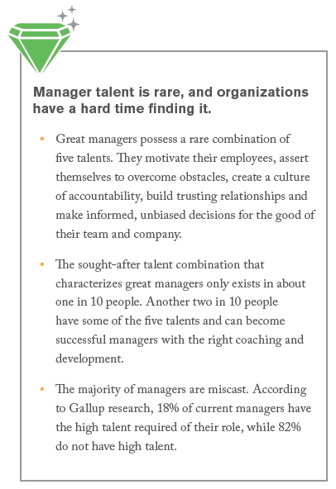

Why we need better leadership
Pace of technological change
Opportunities for technological innovation
Life expectancy of companies
Need for leadership
See Gallups’s State of the American Manager, page 7 https://www.gallup.com/services/182138/state-american-manager.aspx
Notes:
https://globeproject.com/study_2004_2007.html#data
https://www.amazon.com/Losing-Signal-Extraordinary-Spectacular-BlackBerry/dp/1250060176

Slide 14
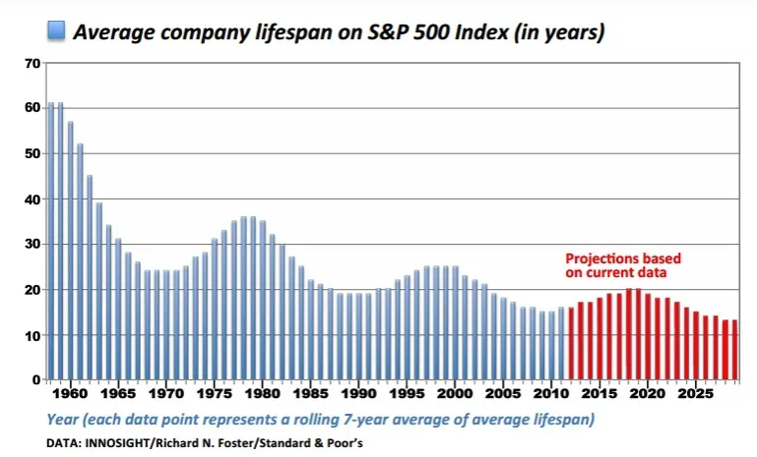
The average life of a company is getting lower
https://www.technologyreview.com/2013/09/10/83087/technology-is-wiping-out-companies-faster-than-ever/
Notes:
When a company becomes large and successful difficult for it to sustain success or even survive for long periods of time, not able to adapt, that’s why leadership is important, navigate change, change, creative, innovative.
Need skills for leadership

Slide 15
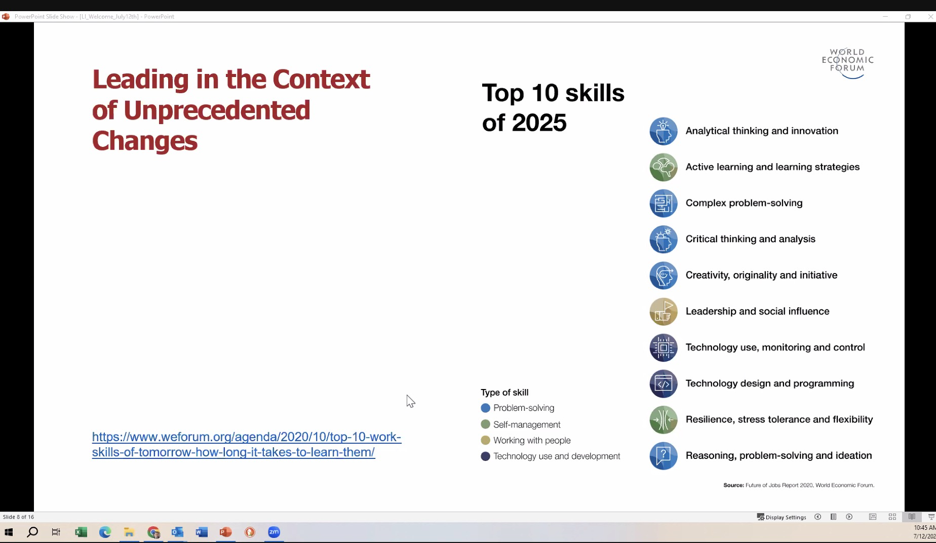
https://www.weforum.org/agenda/2020/10/top-10-work-skills-of-tomorrow-how-long-it-takes-to-learn-them/

Slide 16
Suggestions for learning from the course
Open your minds
challenge yourself and one another
Open your hearts
Learning may involve unlearning
Help and support one another
Open your will
Apply what you are learning
It’s the primary path to development
https://en.wikipedia.org/wiki/Theory_U

Slide 17

So…What is Leadership?
Management is a vertical construct Power makes it work
About getting things done
Functional (Mgt, Sales, Finance, Marketing, Engineering, Production, etc.)
Output orientated operation
Maintain the system
Keep things under control
Management talk, you listen: objectives, strategy KPI’s, targets, etc.
Image is “Orchestra”,
The “Back office”
BAU Business As Usual
https://het-imo.net/the-horizontal-leadership-book
Leadership is a horizontal construct
A creative process where co-creation is dialogical, listening, input oriented
Life is horizontal, more flexible, building trust, feelings, open communications
Leadership is about making this happen, community building, teams, inspiring
Leadership talk is about making sense of things, we hear stories, dealing with reality
Image is “jazz band”, the “Front office”

Slide 18
Three words for Horizontal Leadership
Process: If you want something special to happen, the leader needs to design and create a special participative process to explore the unknown, to research and experiment. The leader does this by being relaxed, observing, taking time to be in touch with the community, asking open questions.
Rhythm and Flow and both needed to create a good process
Dialogue: To explore we are listening, not judging,
Biography: Who am I, what is my work and how do I fit with the organizations biography “the click”

Slide 19
The Four Qualities of Horizontal Leadership
Confronting and making interventions in the process. Stop things that are not working. Start the journey of exploration into the unknown
Steering and guiding the innovation, change and development processes, taking a step together, a continuous process
Coaching the learning process; make people see with fresh eyes, open up their hearts and will to change
Inspiring with a vision of a better life and world

Slide 20
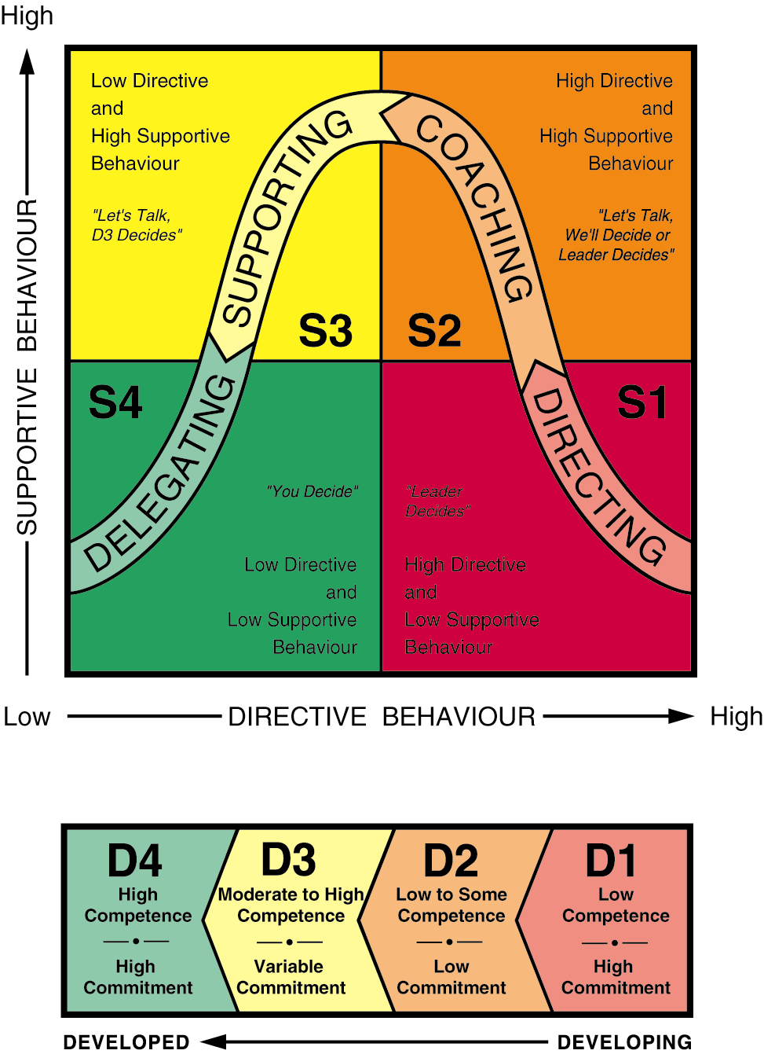
Situational leadership
https://en.wikipedia.org/wiki/Ken_Blanchard

Slide 21
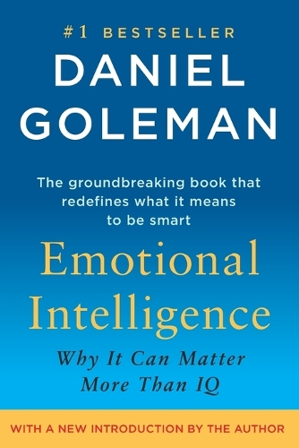
What Predicts High Performance?
High
X
X
X
X
X
X
?
Performance
X
X
X
X
X
X
X
X
X
X
X
X
X
X
X
Low
100
185
Intelligence (IQ*)
* IQ = Intelligence Quotient (a measure of intellectual intelligence: 100 = population average)
Source: Daniel Goleman

Slide 22
What Predicts High Performance?
High
X
X
X
X
X
X
Performance
X
X
X
X
X
X
X
X
X
X
X
Low
Low
High
Emotional Intelligence (EQ*)
* EQ = Emotional Intelligence Quotient (a measure of emotional intelligence, sometimes given a number score)
Source: Daniel Goleman
Source: Daniel Goleman

Slide 23
Emotional Intelligence
What is it?
How would you define it?
5-minute discussion in pairs/groups

Slide 24
Emotional Intelligence Defined
“The capacity for recognizing our own feelings and those of others, for motivating ourselves, for managing emotions well in ourselves and in our relationships.”
Source: Daniel Goleman
‘Emotional Intelligence’
Notes:
How do you feel at this present moment?

Slide 25
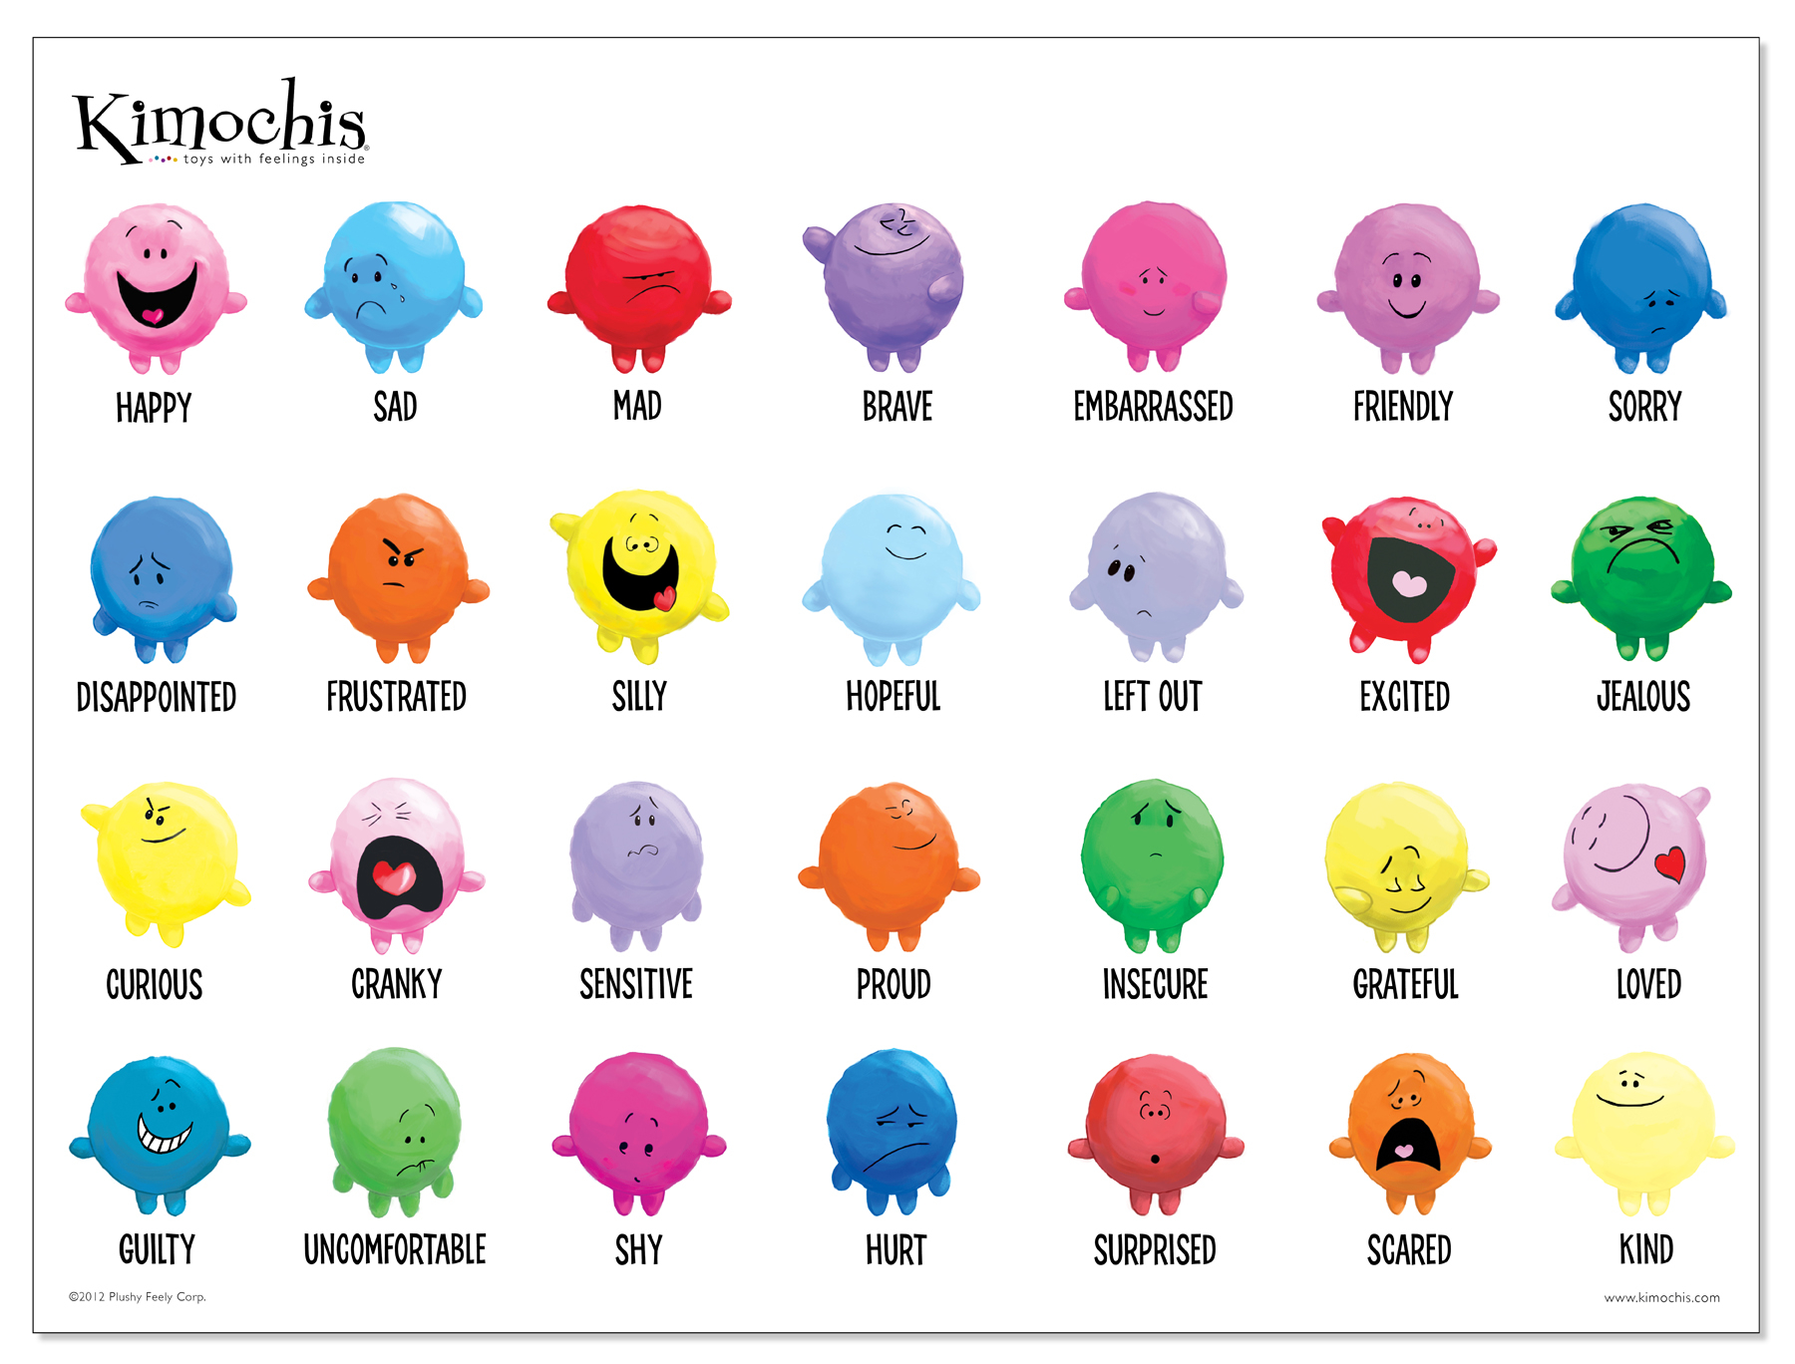
How do you feel at this moment?
Notes:
How do you feel at this present moment?
How motivated are you to do this course at the present moment?
Share your feeling and motivations within the group. Be honest with yourselves.

Slide 26

Emotional Intelligence begins with understanding yourself
Self
Others
Self-
Awareness
Social
Awareness
Awareness
Source: Daniel Goleman
Actions
Self-
Management
Relationship Management
Positive impact on others
Notes:
Understanding, personality, culture, beliefs, norms and bad habits!
- May have been told that you must never express your feelings or motivations!
Self management –
What action do you take to motivate yourself?
What do you do to make sense of your life? To give it purpose?
What is your (change) agenda? What do you want to achieve? Which bad habits to turn into effective ones. Which action to challenge beliefs, change yourself
Research made on personal change. Read the book “Immunity to change”
14 frogs on a wall. 3 decided to jump. How many remaining on the wall? Difference between deciding and actually doing it. Between intention and action.
Dr told people that high risk of heart failure – need to take medications, change diet etc
6 out of 7 didn’t change…..so they died prematurely. Only 1 changed
Didn’t take action!

Slide 27
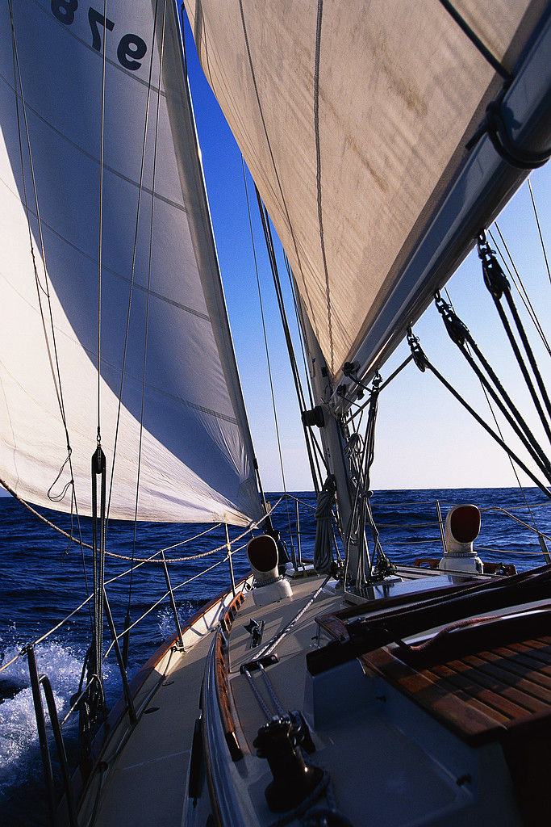
Personal development and Team Leadership – a journey

Slide 28
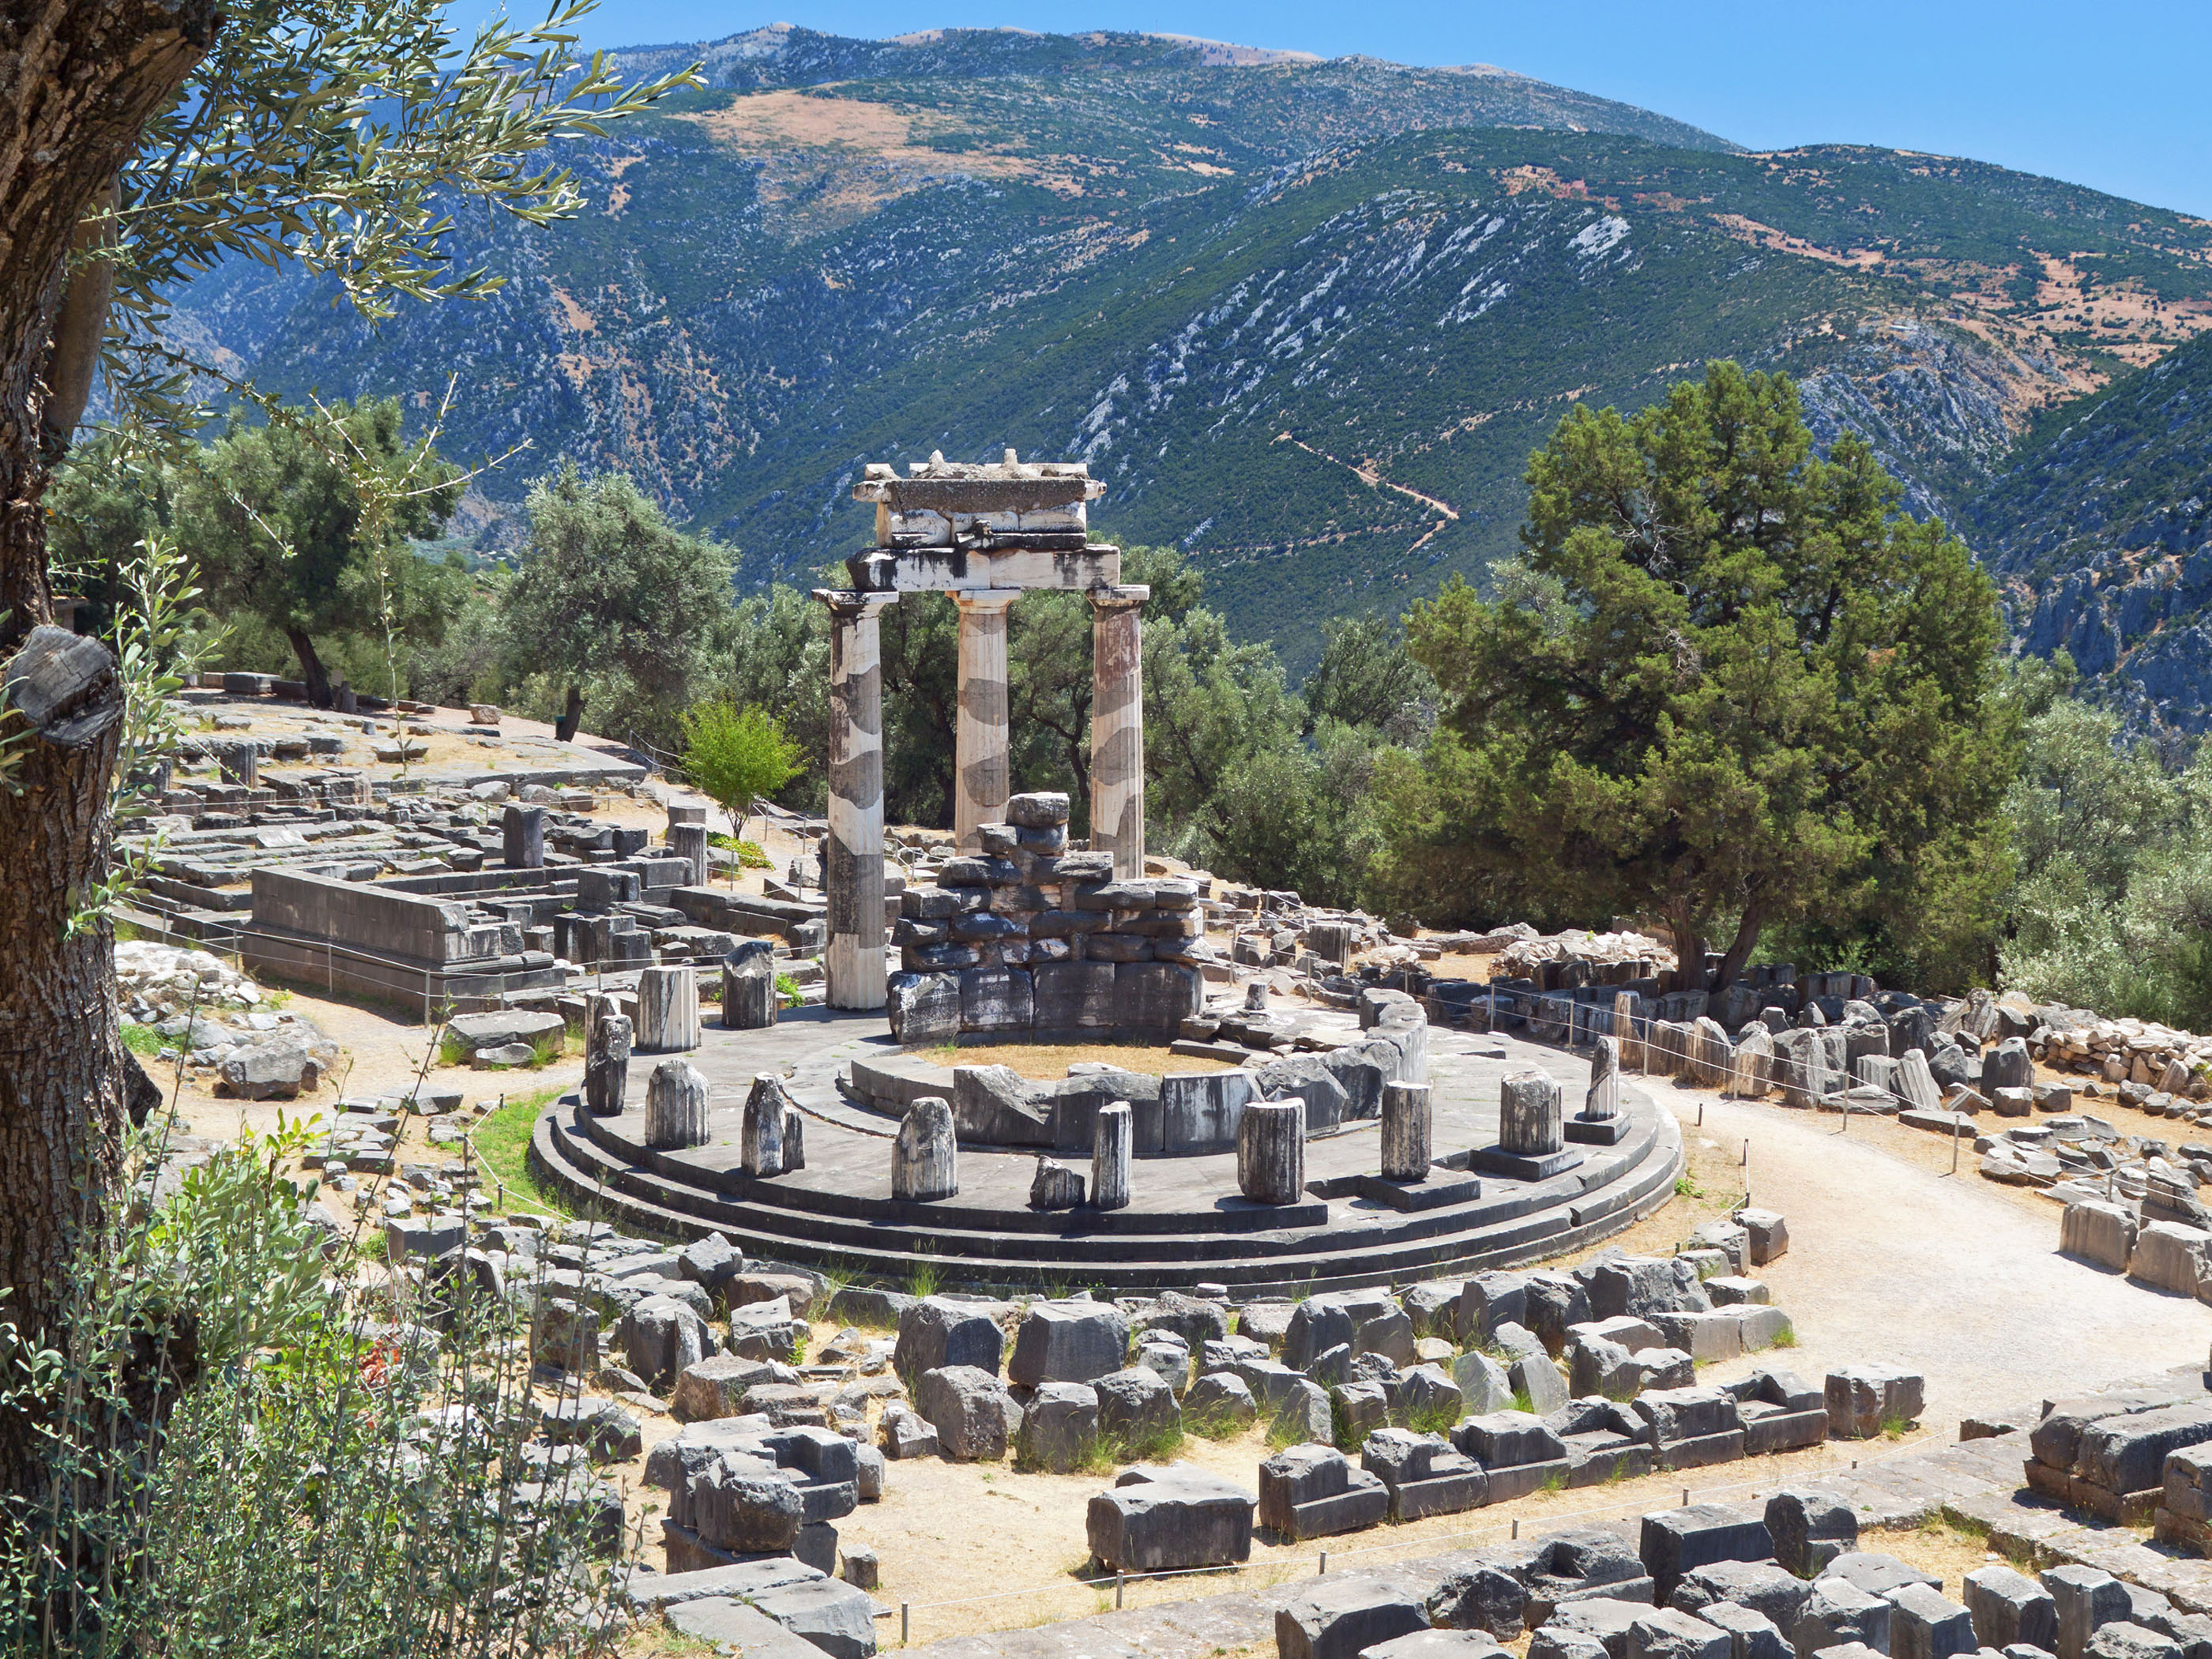
We will begin our journey in Greece
Notes:
Poioi einei oi Ellines?

Slide 29
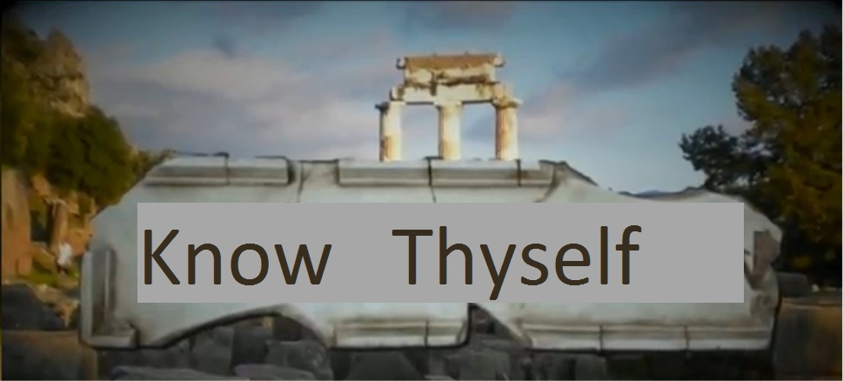

Slide 30
First:
Learning to talk about yourself and building rapport with others
(form international groups of six)

Slide 31
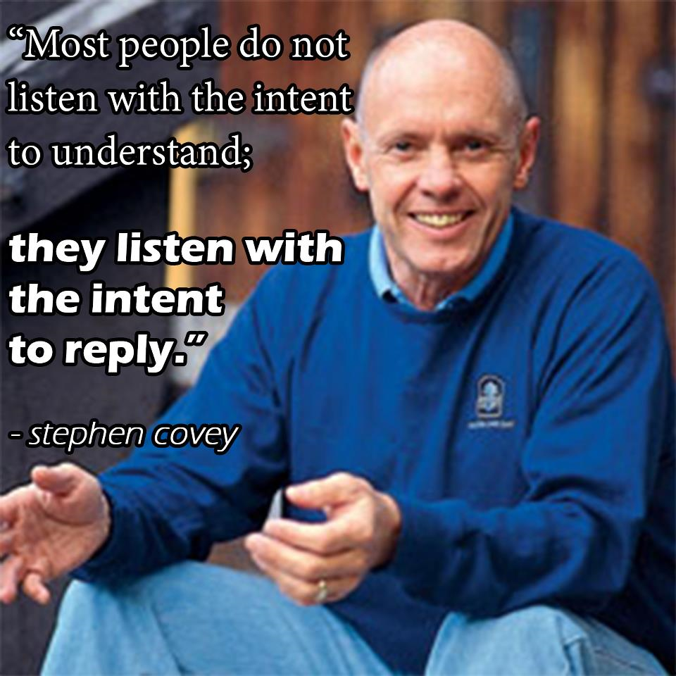
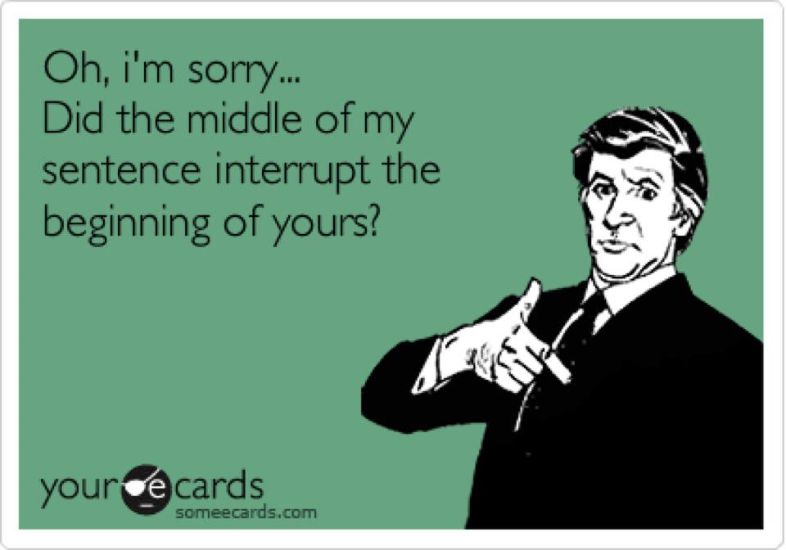
About listening - practice active listening. Activity

Slide 32
Group exercise – Creating rapport
Round 1: In pairs, take 2 minutes each to explain “who” you are
Round 2: Change partners, take 2 minutes each to explain “who” you are. This time don’t repeat anything you said in the previous round
Round 3: Change partners, take 2 minutes each to explain “who” you are. This time don’t repeat anything you said in the previous two rounds
Notes:
Purpose: To be successful in life we need to build strong relationships with people. In order to build relationships with people, we first need to create rapport. We need to share something with them, reveal something about us, that shows that we have something in common, that we are connected in some way.

Slide 33
Group exercise - Debrief
In your group discuss what happened?
What changed?
How do you feel after this exercise?

Slide 34
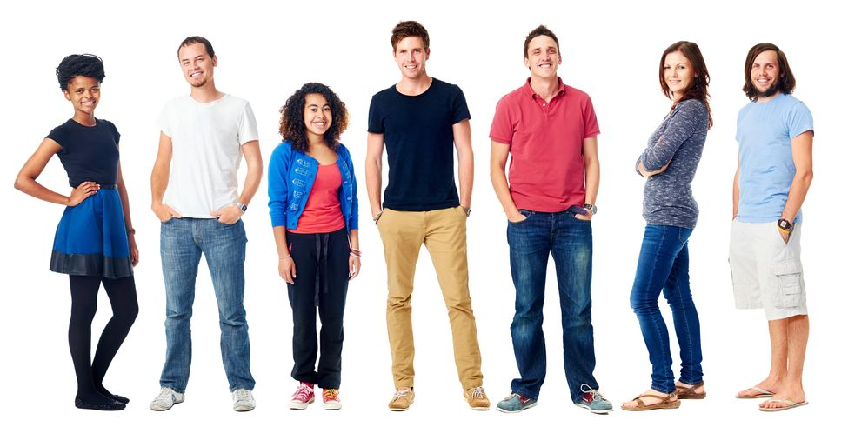
Are we really all that different from each other?

Slide 35
Write a word you associate with money on each of the lines
MONEY
Notes:
How many words will we have in common in the class?

Slide 36
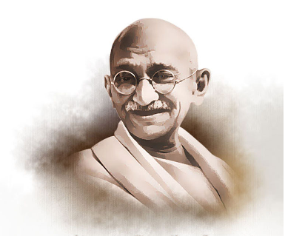
Diversity & Synergy
“Civilization is the encouragement of differences”
Mahatma Gandhi

Slide 37
What influences behaviour?
Why did people think we would have the same ideas?

Slide 38

The tribal influence is still with us
For 140k years, perhaps longer, tribes enabled bigger communities to exist; how we behaved in the tribe/clan was critical to our survival as individuals
Even today:
Question 1: What is every human’s greatest fear?
Answer: Rejection
Result: ‘Forces’ us to follow behavioral norms
Question 2: What is every human’s second greatest fear?
Answer: Not being accepted
Result: ‘Forces’ us to follow behavioral norms
These ‘survival’ responses are deeply ingrained within us
To be able to deal with them we need to:
face them,
understand them, and
become ‘mindful’ of how we respond to those from outside our ‘tribe’
Book: ‘Tribal Leadership” By David Logan
Notes:
Link is to a TED talk. The main message:
There are those who fight the uncomfortable, and
There are those who can face the uncomfortable.
Those who face it have three solutions: People, Places, Patience

Slide 39
Why do we behave the way we do?
Learn to be mindful of how you are seen by others, and why
The ‘iceberg’ model:
Behavior
Let’s explore this now
Observable
The hidden attributes drive behavior
Culture learned attitudes & beliefs
Personality mainly innate/genetic
‘Hidden’
Human nature – innate/genetic
39

Slide 40
Awareness: Mapping Uncertainty Avoidance with Power-distance
Created by K. Pope from Hofstede/Bond results

Slide 41
Awareness: Mapping Power distance with Individualism/Collectivism
Example: Tough to implement SMWT’s*:
Highly individualistic
But, tends to want others to take responsibility
Created by K. Pope from Hofstede/Bond results
See https://www.hofstede-insights.com/country-comparison-tool?countries=
* SMWT’s: self-managed work teams

Slide 42
Culture shock: The confusion, disorientation and emotional upheaval of moving to a different ‘country’
This is what generally happens on an intensive graduate
program too!
High
Mood
Phase I
- Novelty
Phase II
Disillusion
-ment
Phase III
- Frustration
Phase IV
- Learns to cope
Low
1 2 3 4 5 6
Months in ‘foreign’ culture
Kübler-Ross, E. (1969). On Death and Dying (The original framework for the Five Stages of Grief).

Slide 43
Behaving professionally: So what can I do to respond better?
Understand yourself:
The national cultural influences that helped ‘form’ you
How those impact your ‘usual’ behavior
Your personality – unique to you but cultural overtones impact behavior
And, understand others:
Neither of you is ‘right’, the world needs all types all the time
Learn to observe how they behave in certain situations
Learn to observe yourself in your interactions:
What just happened, and why?
I’m doing it again!
If I had behaved differently, would I have been more successful?
These will help you to become more ‘mindful’
= more effective
= better liked
= live a fuller life
= be more successful
= happier and less stressed

Slide 44
Activity exploring culture
Pair with someone that you do not know well, from a different country
Person A, introduces themselves. Tells their nationality
Person B says what their impression of that nationality is. Person A does not respond
Reverse roles
Discuss whether the first impressions of each national culture were true
Discuss what is common in the two cultures
Discuss what happened, what did you learn, be ready to share your conclusions

Slide 45
Four key elements in EQ*:
Self-awareness
Self management
Social awareness
Relationship management
Source: Daniel Goleman
* EQ = Emotional Intelligence Quotient
For more see video with Daniel Goleman explaining Emotional Intelligence click here

Slide 46
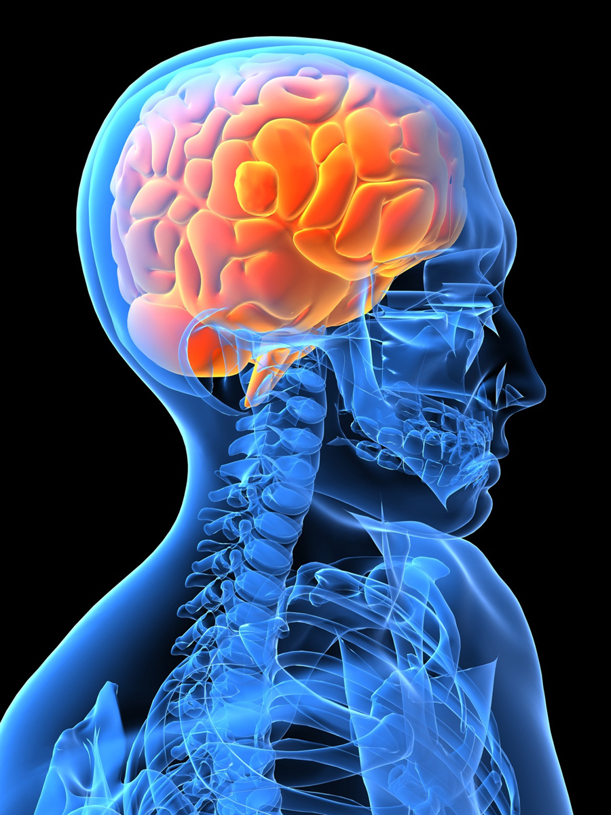
“Emotional Intelligence can be learned.
The process is not easy. It takes time and commitment.”
Daniel Goleman
Emotional Intelligence
46

Slide 47
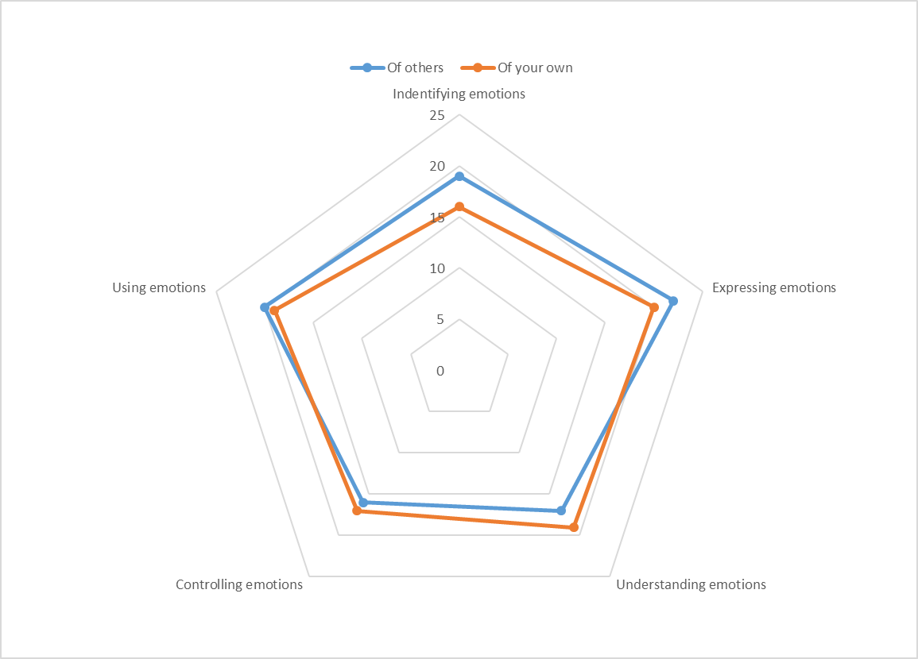
Introducing the EQ questionnaire:
Download link is here!

Slide 48
So, for next class:
Think deeply about your commitment to the work of the class.
Complete the EQ questionnaire (previous slide) – bring results to class next week
Watch the Goleman video (class quiz)
Think about what you want from the course. In week 14, by what criteria will you consider the course to have been a success?

Slide 49
Learning Log

Slide 50
About the prof
Details, background, and contact information will be in the presentation mailed to you
Prof will provide lecture materials and exercises, and will act as facilitators and coaches to teams and individuals as you develop through the course

Slide 51
Glossary of terms used today
EQ = Emotional Intelligence Quotient; a measure of emotional intelligence sometimes given a number score. Often used interchangeable with EI.
IQ = Intelligence Quotient; a measure of intellectual intelligence where the population average is 100 (there is some controversy about the scoring system since it tends to favor certain types of intellectual intelligence)
EI = Emotional Intelligence, the concept is often used interchangeably with EQ, though EI is usually expressed more generally as ‘high’, ‘average’, or ‘low’
MBTI = Myers Briggs Type Indicator; a personality type indicator system that we will be exploring in future classes

Slide 52
More material about today’s topics:
About Google’s research on effective teams (Article) (Video link here)
‘Emotional Intelligence – why it can matter more than IQ’ by Daniel Goleman (Amazon) (Video link here)
‘Feel the Fear and Do it Anyway’, by Susan Jeffers (Amazon) (Full audio book) (Video book review)
‘No asshole rule’ by Robert I. Sutton (Amazon) (Dramatized book review) (Author interview)
Links on measuring EI (Bar-On test) (Online test) (General) (Hayes Group)
‘Five Dysfunctions of a Team’ by P. Lencioni (Amazon) (Summary 7 mins)
“Immunity to change” by Robert Kegan and Lisa Laskow Lahey
(Amazon) (Summary 14 mins)

Slide 53
Addendum to presentation: About the prof.

Slide 54
About Andrew PRIOR
Executive Leadership and Team Coach (Certified with EMCC), MBA (Edhec), Professional Engineer
BSc. Honors degree Engineering, Diploma in Management, Certificate in Environmental Mgt.
25 years professional experience
13 years (engineer, manager and leader)
At Multinationals: Motorola and Corvis (now Level3)
Systems engineering, engineering management, sales, project/program management, marketing, new business and product development
Since 2004 independent management consultant
(Innotiimi, Abilways, theblueoceancompany, teamalchemy, MIT, IIL etc)
Leadership, Teams and Organizational Learning & Development
EDHEC learning facilitator for MBA
Eurecom from 2010-2017 and from 2023 “TeamLead”
MIT Professional Education from 2022: Leadership and Innovation
European with British/Scottish/French/Spanish culture
Married with 2 kids (speak French, English and Spanish)

Slide 55
Consulting (strategy)
Andrew’s Industry experience
Team Leadership
& performance
New Product
Development
Telecom Operators
Public Safety
Learning &
Development
Teaching
Training
Systems
Engineering
Social Innovation
MOD
Coaching and Mentoring
Mobile Data
Agile-Lean
Finance
Innovation Management
Secure Encrypted
Communications
EU Institutions
Government
Microwave
Networks
Office of President
NGOs
Marketing
Quality Management
ISO 9001
Change Leadership
Transportation
Railways
Freelancing
Oil and Gas

Slide 56
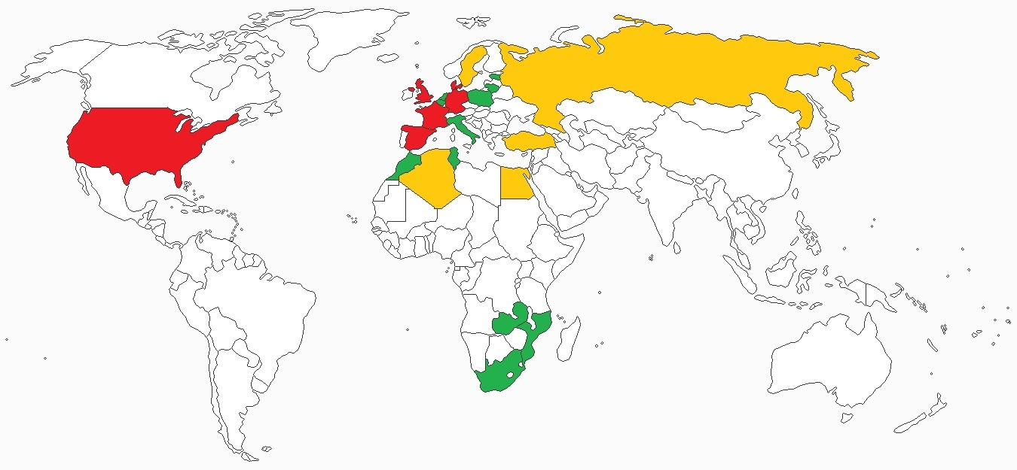
Countries in which Andrew has lived/worked extensively
6
UK (born)
France (now)
USA
Spain
Germany
Denmark
13
Tunisia
Morocco
Mozambique
Zambia
Kuwait
South Africa
Poland
Lithuania
Belgium
Luxemburg
Italy
Netherlands
Estonia
5
Finland
Algeria
Egypt
Turkey
Russia
6
Countries where I have/have had ‘homes’: house, apartment, etc.
5
Countries frequently visited over years – some extended stays
13
Countries frequently visited often for business purposes/projects

Slide 57
Andrew’s contact details:
Email
prior@eurecom.fr
andrew.prior@teamalchemy.eu (personal and business)
Mobile: +33 6 2101 5896
Skype: aprior
Linkedin: https://www.linkedin.com/in/andrewprior/

Slide 58
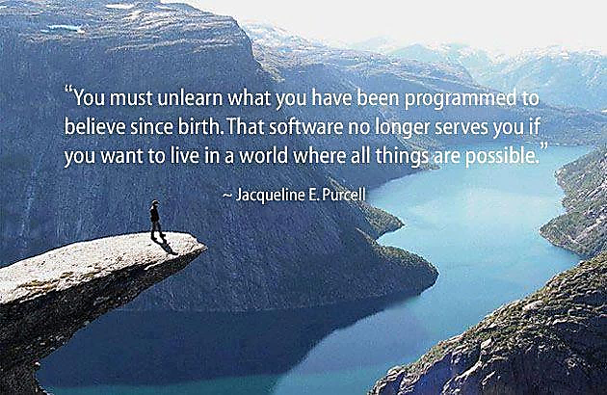

Slide 59
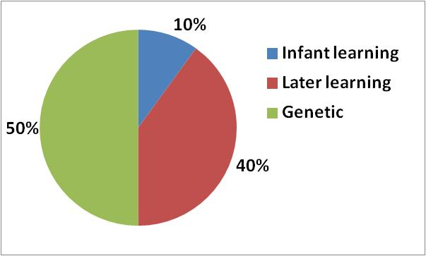
How much choice do we have?

Slide 60
Back to our discussion about Emotional Intelligence

Slide 61
The Competency Framework
Self-
Awareness
Social
Awareness
Emotional Self-Awareness
Accurate Self-Assessment
Self-Confidence
Empathy
Organizational Awareness
Service Orientation
Source: Daniel
Goleman
Self-
Management
Relationship Management
Emotional Self-Control
Transparency
Adaptability
Achievement Orientation
Initiative
Optimism
Developing Others
Inspirational Leadership
Change Catalyst
Influence
Conflict Management
Teamwork & Collaboration

Slide 62
Emotional Intelligence begins with understanding yourself
Self
Others
Self-
Awareness
Social
Awareness
Awareness
Source: Daniel Goleman
Actions
Self-
Management
Relationship Management
Positive impact on others
Notes:
Understanding, personality, culture, beliefs, norms and bad habits!
Self management – Own change agenda to turn bad habits into effective ones. Take action to challenge beliefs, change yourself
Research made on personal change. Read the book “Immunity to change”
14 frogs on a wall. 3 decided to jump. How many remaining on the wall? Difference between deciding and actually doing it. Between intention and action.
Dr told people that high risk of heart failure – need to take medications, change diet etc
6 out of 7 didn’t change…..so they died prematurely. Only 1 changed
Didn’t take action!

Slide 63
Research supports this:
Self-Awareness is at the heart of the model:
ECI research found that if people lack Self-Awareness, their chances of having Self-Management and Social Awareness are much reduced
Low
Self-
Awareness
17% chance
Social
Awareness
4% chance
Self-
Management
Source: Daniel Goleman

Slide 64
Helping you understand yourself
Group task: Discuss, complete the matrix, and define the dimensions
Known by me & known by others
?
?
?

Slide 65
Jo Hari Window
Helping you understand yourself
Known
by the self
Unknown
by the self
Solution?
Known
by others
Open
(arena)
Blind
spot
Self Exposure
Unknown
by others
Hidden
(behind wall)
Unknown
http://en.wikipedia.org/wiki/Johari_window

Slide 66
Jo Hari Window
Known
by the self
Unknown
by the self
Known
by others
Open
(arena)
Blind
spot
Self Exposure
Unknown
by others
Hidden
(behind wall)
Un-known

Slide 67
Jo Hari Window
Known
by the self
Unknown
by the self
Solution?
Ask for (solicits) feedback
Known
by others
Open
(arena)
Blind
spot
Unknown
by others
Hidden
(behind wall)
Un-known

Slide 68
Jo Hari Window
Known
by the self
Unknown
by the self
Solution?
Ask for (solicits) feedback
Known
by others
Open
(arena)
Blind
spot
Unknown
by others
Hidden
(behind wall)
Un-known

